Slide 1
Computer Operating System Experiment

Slide 2
Memory managment
Lab 7

Slide 3
Roadmap
the memory management
the memory allocation
experiments
Q&A

Slide 4
Objective:
● Learn to design and to implement a custom memory allocator
  First fit
  Best fit
  Worst fit
you will design and implement a memory allocation system to work in user space and apply the concepts you have studied so far.

Slide 5
Memory Management
CPU
Fetch and Execute
Cycle
Main
Memory
registers
PC
ALU
L1
Cache
L2
Cache
Memory
Bus
Code
Data
Stack
System
Bus
I/O Bridge
Bus interface
I/O Bus
Memory
Hierarchy:
USB
Controller
Graphics
Card
Disk
Code

Slide 6
Memory Management
Memory Hierarchy
  cache frequently accessed instructions and/or data in local memory that is faster but also more expensive
registers
L1 Cache (SRAM)
L2 Cache (SRAM)
Main Memory (DRAM)
Disk or Flash Secondary Storage
Remote Networked Disks

Slide 7
Address binding
How to put a process in a physical address?
  Addresses in source program are symbolic
    Example: count variable
  A compiler binds them to relocatable addresses
    Example: 14 bytes from beginning of this module
  Linker and loader bind them next to absolute addresses
    Example: 74014

Slide 8





Generate logic address
0
1000
Fun lib
Fun lib
0
100
1100
prog P
:
:
foo()
:
:
end P
P:
:
push ...
inc SP, x
jmp _foo
:
foo: ...
:
push ...
inc SP, 4
jmp 75
:
...
:
:
:
jmp 175
:
...
:
:
:
jmp 1175
:
...
75
175
1175
compile
assembly
link
loader
(relocatable code )

Slide 9
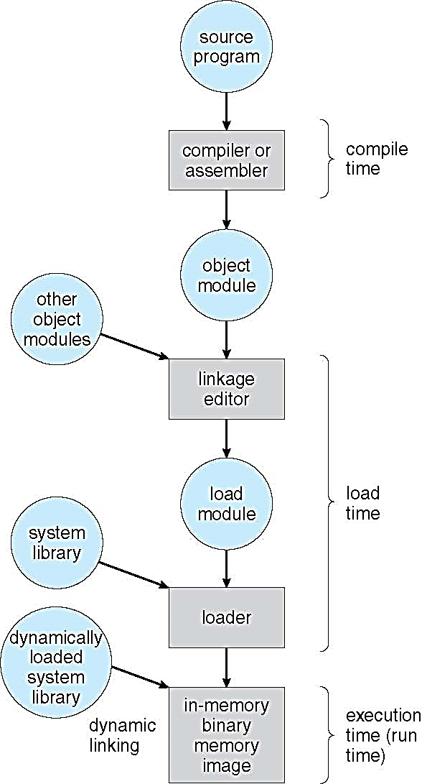
How to bind inst./data to mem. address?
Compile time
  If memory location known a priori, absolute code can be generated; must recompile code if starting location changes
    Example: COM files in MS-DOS
Load time
  Must generate relocatable code if memory location is not known at compile time
Execution time
  Binding delayed until run time if the process can be moved during its execution from one memory segment to another
    Need hardware support for address maps
      Example: Base-Limit registers

Slide 10
Logical vs. physical address space
Logical address (CPU address)
  CPU logically sees addresses
  Logical address space: set of all logical addresses generated by a program
Physical address (Memory address)
  Address of memory line
  Physical address space: a physical address (also real address, or binary address)
  The set of all physical addresses corresponding to these logical addresses is a physical address space.
May be equal or not
  Equal: compile-time and load-time address bindings
  Not equal: execution-time address binding
    In this case, logical address is said virtual address

Slide 11
Memory allocation

Slide 12
Memory allocation
Different types
  Contiguous
    Each process is in a single section of memory that is contiguous to sections of others
  Segmentation
    Each process is divided into different segments; each one is located in different part
  Paging
    Each process is divided into same–small–size pages; some of them are swapped in/out

Slide 13

Contiguous allocation
Relocation registers used to protect user processes from each other, and from changing operating-system code and data
  Base register contains value of smallest physical address
  Limit register contains range of logical addresses
    Each logical address must be less than the limit register

Slide 14

Multiple-partition memory allocation
  Degree of multiprogramming limited by number of partitions
  Variable-partition sizes for efficiency (sized to a given process’ needs)
  Hole – block of available memory; holes of various size are scattered throughout memory
  When a process arrives, it is allocated memory from a hole large enough to accommodate it
  Operating system maintains information about:
  a) allocated partitions b) free partitions (hole)

Slide 15
Dynamic storage-allocation problem
How to satisfy a request of size n from a list of free holes?
  First-fit: Allocate the first hole that is big enough
  Best-fit: Allocate the smallest hole that is big enough; must search entire list, unless ordered by size
    Produces the smallest leftover hole
  Worst-fit: Allocate the largest hole; must also search entire list
    Produces the largest leftover hole
First-fit and best-fit better than worst-fit in terms of speed and storage utilization

Slide 16
Fragmentation problem
External Fragmentation
  Total memory space exists to satisfy a request, but it is not contiguous
Internal Fragmentation
  Not whole of allocated memory is filled by the process memory
First fit analysis reveals that given N blocks allocated, 0.5 N blocks lost to fragmentation
  1/3 may be unusable -> 50-percent rule

Slide 17
Today's Lab
Experiment 1: customed memory allocation
Experiment 2: observation the fragmentation

Slide 18
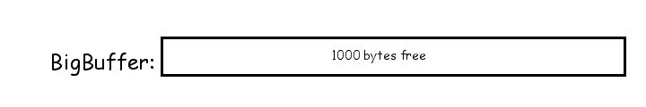
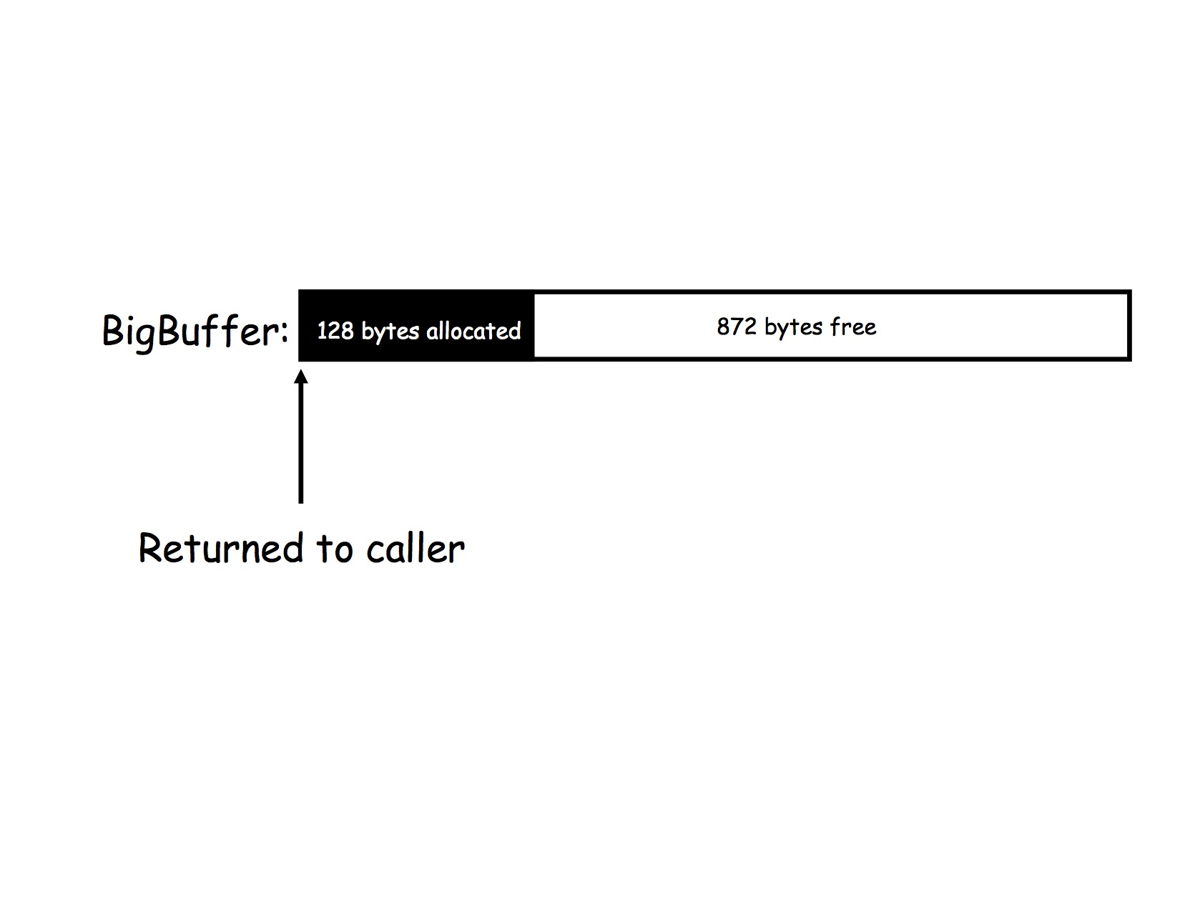
Core idea
your code will need to keep track of any space it gives away.
Step 1：Your array, then, is large enough to allocate a maximum of 1000 bytes, and no more. Initially, all 1000 bytes are free.
Step 2：let's consider what happens when the call allocate (128) gets made. You will need to allocate the first 128 bytes and return a pointer to the first by to the caller

Slide 19
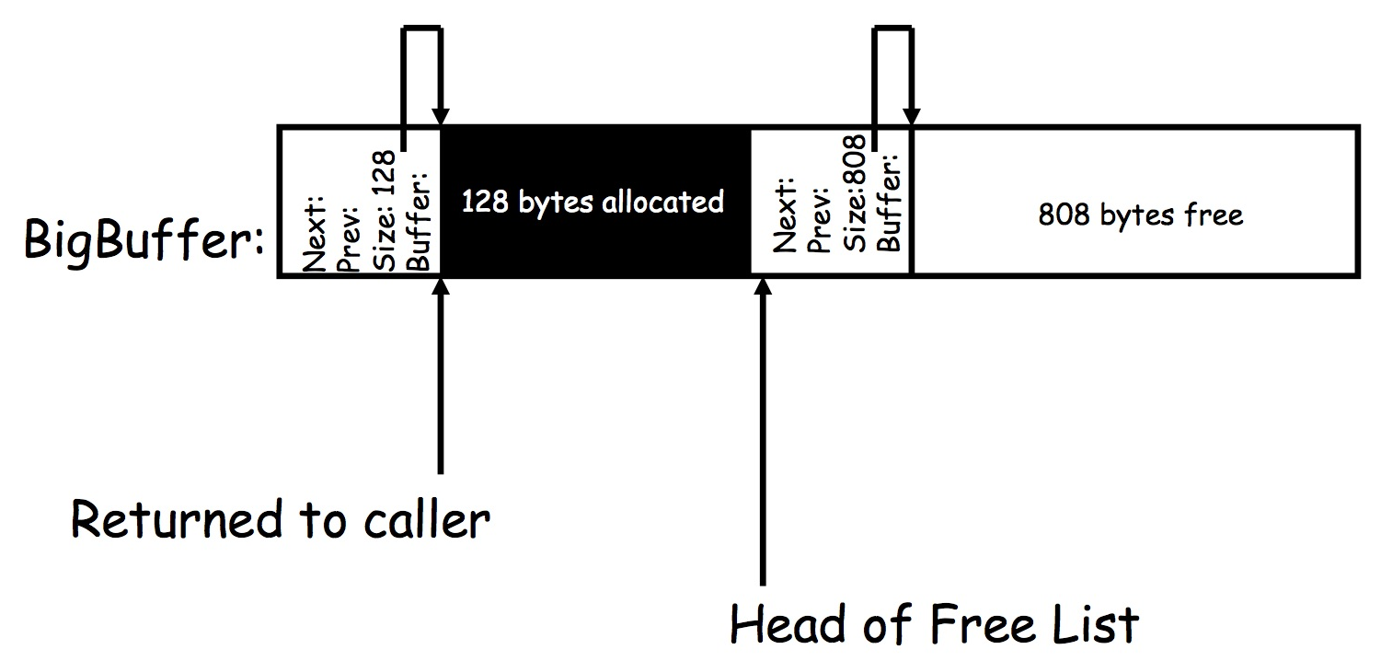
Core idea (cont.)
you need to maintain a data structure that keeps track of what space is allocated and what space is free.
struct dnode {
struct dnode *prev;
struct dnode *next;
void *data;
int size;
};
The next and prev pointers allow this record to be maintained on a doubly linked list. The size indicates the size of the block, and the buffer points to the beginning address of the block.

Slide 20
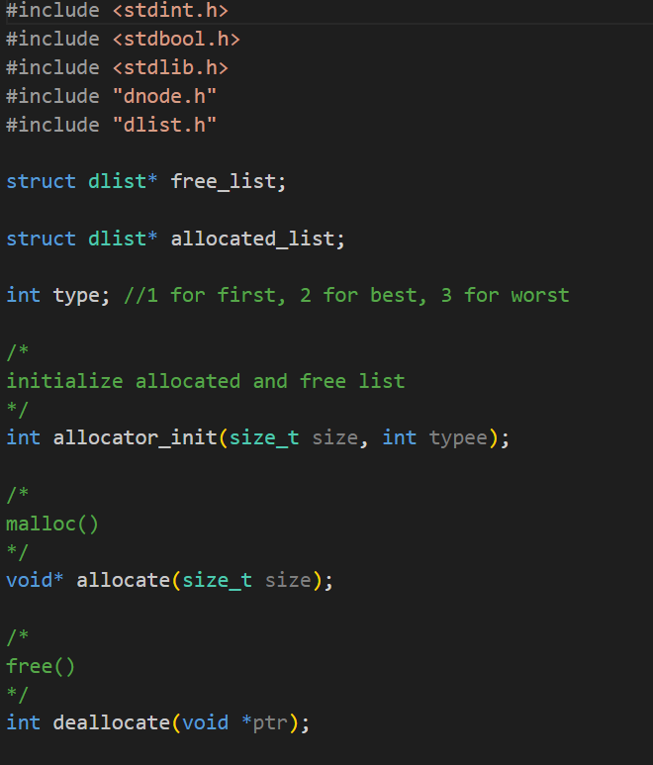
Core idea (cont.)
You can use two dlink to record the free blocks and allocated blocks respectively
  free_list
  allocated_list
allocator.h

Slide 21
Code structure
Code
/src
/include
We provide the implementation of a doubly-linked list abstract data type (ADT).
dlist.h dlist.c
dnode.h dnode.c
struct dlist *mylist = dlist_create();
nodePointer1 = dnode_create();
dnode_setdata(nodePointer1, str1);
dlist_add_back(mylist, nodePointer1);
Free to modify the code.

Slide 22


